Slide 1

EconCast PH
Policy Forecasting for the Philippines using Machine Learning Donn Bryan Julian, CLSSBB
04/17/2025

Slide 2
The Policy Forecasting Gap
Policymakers need fast, data-driven forecasts to simulate policy outcomes
Existing tools are static, fragmented, or overly technical
There is limited local infrastructure to simulate long-term effects of social, economic, or environmental decisions

Slide 3
Objective
Build a transparent and interactive tool for estimating key national outcomes based on historical data and policy inputs
Focus on GDP, poverty rate, and GHG emissions per capita
Enable "what if" scenario analysis with immediate feedback

Slide 4
Data Sources
All data sourced from the World Bank Open Data
Includes indicators across:
Economic (GDP, trade, inflation)
Social (poverty, education, inequality)
Environmental (emissions, energy use)
Time span: 1970 to 2021, single country focus: Philippines

Slide 5
Forecast Targets
GDP per Capita (GDP per capita (current US$)_ccdr)
Economic growth
Poverty Rate (% under $5.50/day) (Poverty headcount ratio at $5.50 a day (2011 PPP) (% of population)_ccdr)
Welfare indicator
GHG Emissions per Capita (tons) (Per capita GHG emissions (tons/capita)_ccdr)
Environmental sustainability

Slide 6
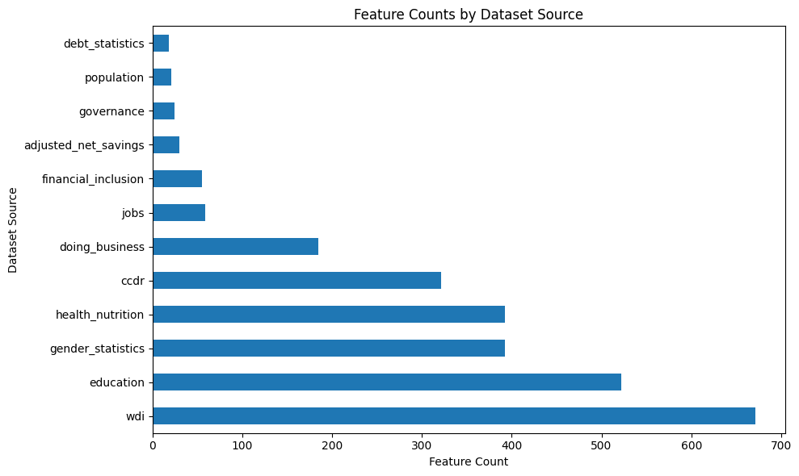
From 2,692 Indicators to What Matters
Removed:
Zero only columns
Low variance features
Sparse historical data
Applied:
P value filtering
Autocorrelation screening
Final usable features: 1,175

Slide 7
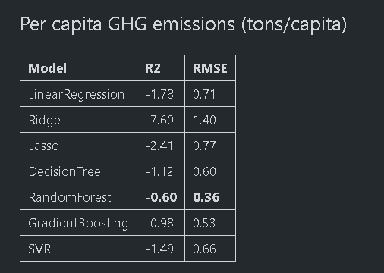
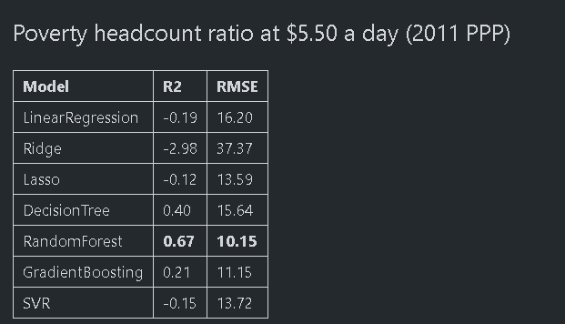
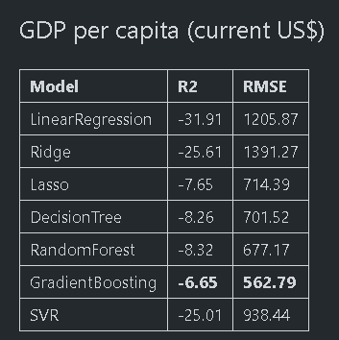
Model Selection and Evaluation
All applicable models were tested, including:
Linear Regression, Ridge, Lasso
Random Forest, Gradient Boosting, SVR, Decision Tree
Metrics: R², RMSE, 5 fold cross validation
Random Forest selected based on balance of accuracy, robustness, and interpretability
Conclusion
Gradient Boosting worked best for GDP per capita but overall performance was poor.
Random Forest was the most consistently effective across all targets.
Poverty prediction was the most stable and interpretable.
Emissions and GDP forecasting may require more focused features or advanced modeling techniques to improve accuracy.

Slide 8
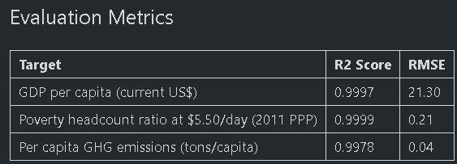
Forecast Accuracy (Random Forest)
High performance enabled strong, reliable policy simulations

Slide 9
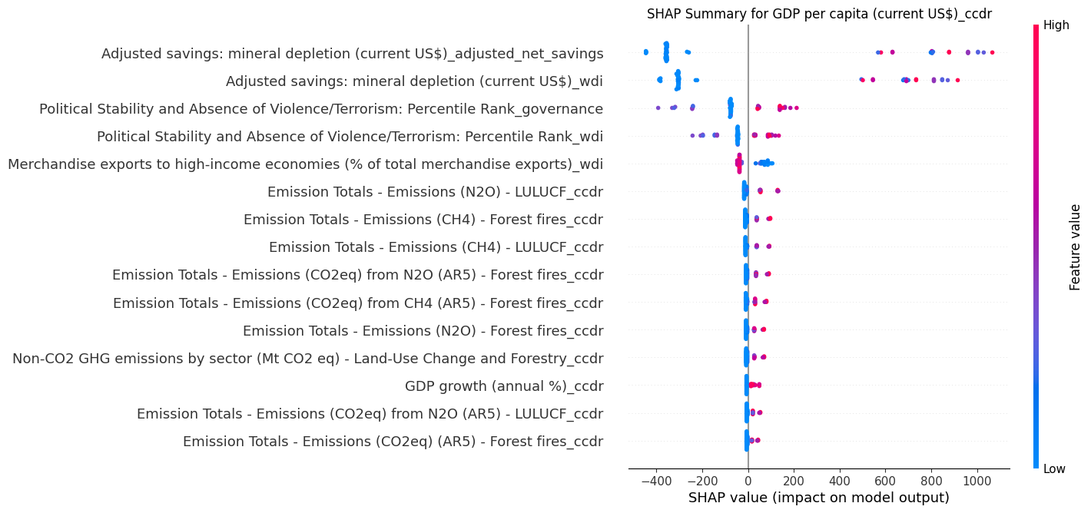
What Drives the Forecasts?
For GDP per capita (current US$)
Adjusted savings: mineral depletion (current US$)
Merchandise exports to high-income economies
Political stability indicators
Emission totals from LULUCF and forest fires
Insights:
GDP growth is primarily associated with extractive industries and mineral depletion.
Political stability and trade patterns also contribute significantly.
Emissions data appears marginal but may signal broader industrial activity.

Slide 10
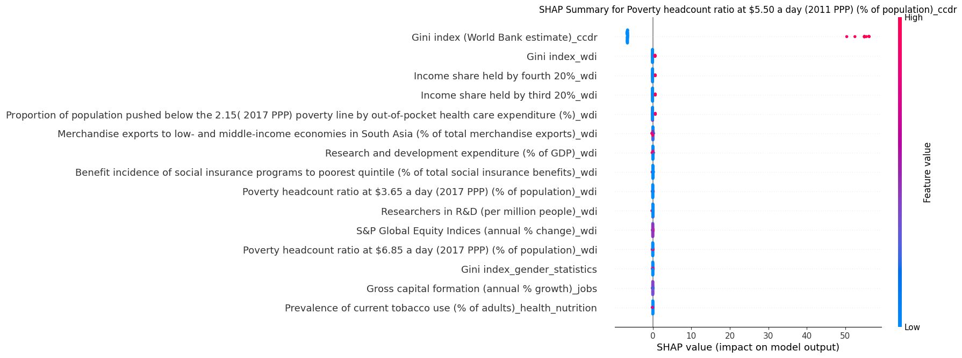
For Poverty headcount ratio at $5.50/day (2011 PPP):
Top Features by Random Forest Importance:
Gini index (inequality measure)
Health-related poverty metrics
Income share across population quintiles
R&D expenditure and social program targeting
Insights:
Inequality (Gini index) dominates as the strongest explanatory factor for poverty levels.
Out-of-pocket health expenditure and social safety net targeting to lower quintiles are also key levers.
Education and R&D contribute marginally, likely via structural effects.

Slide 11
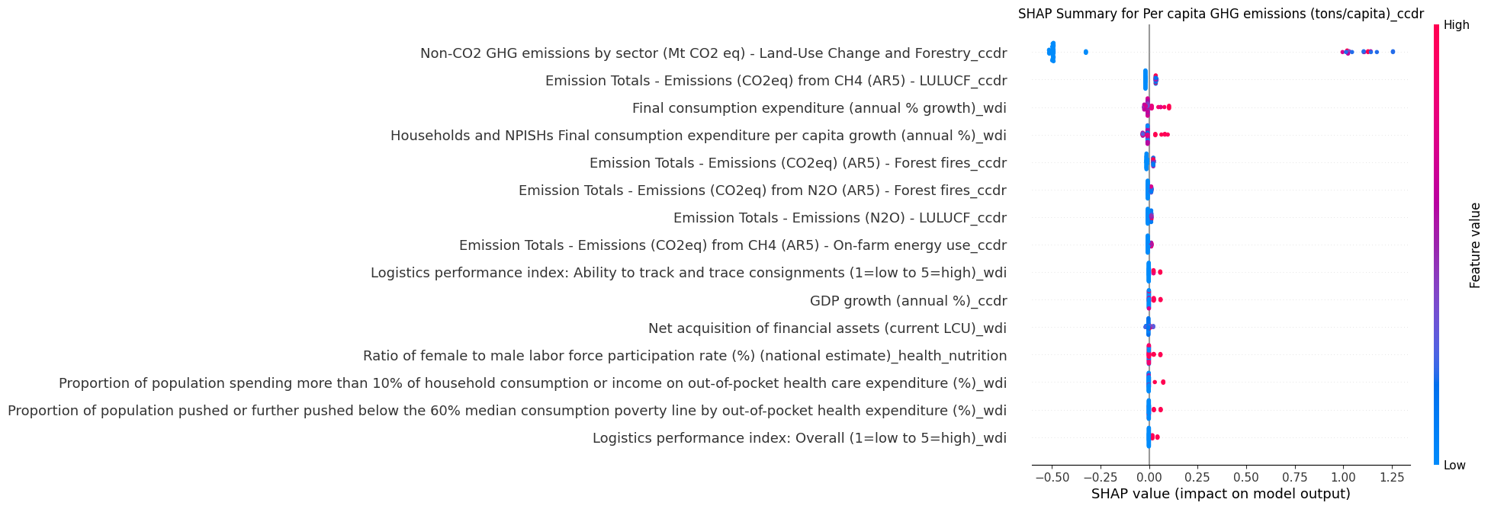
For Per capita GHG emissions (tons/capita)
Top Features by Random Forest Importance:
Non-CO2 emissions from land-use change and forestry
CH₄ and N₂O emissions from agriculture and energy use
Household consumption growth
Insights:
Emissions are primarily driven by land-use, forest fires, and agricultural emissions.
Consumption patterns and economic growth have a measurable but secondary role.

Slide 12
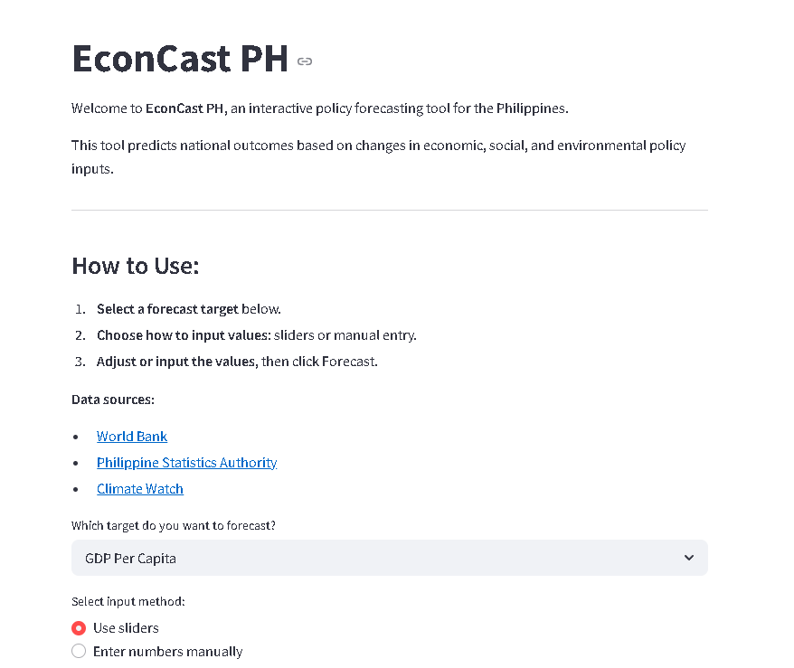
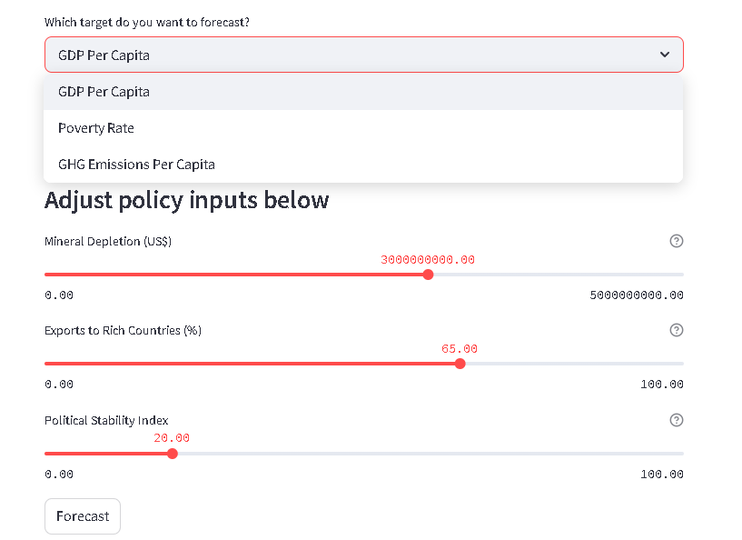
Deployment: Hugging Face + Streamlit
Deployed on Hugging Face Spaces using Streamlit
User selects a target, inputs policy values (sliders or manual), gets forecast + explanation
Hosted at: https://huggingface.co/spaces/FatYuna19/econcast ph

Slide 13
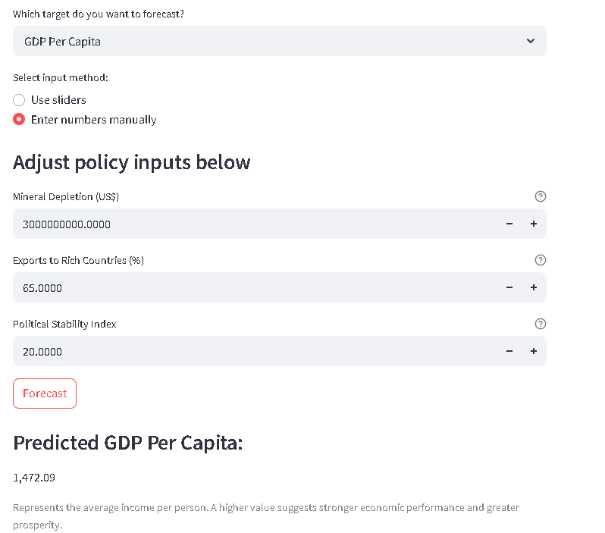
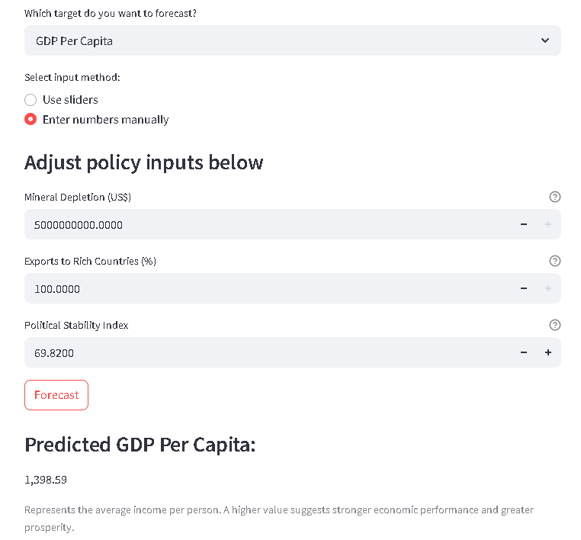
What Happens When You Change a Policy Lever?
Despite higher export orientation and political stability in Scenario B, the increased mineral depletion may have lowered the forecasted GDP per capita. This highlights how environmental degradation can offset economic policy gains. Scenario-based simulations like these help policymakers weigh tradeoffs between growth, resource use, and governance improvements.

Slide 14
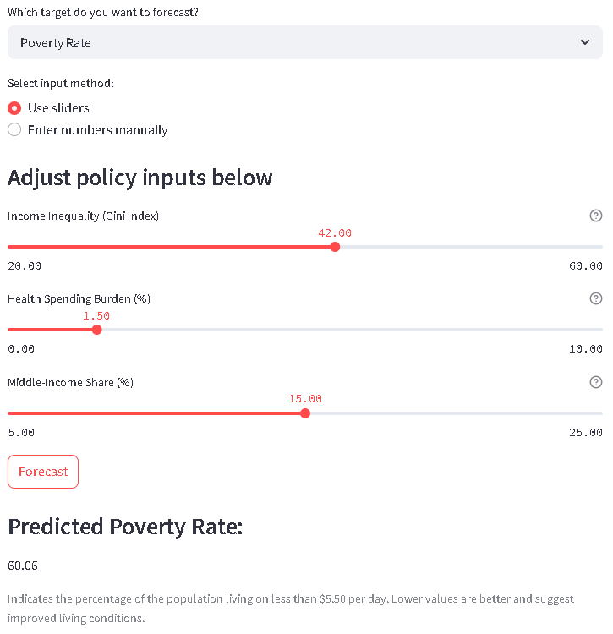
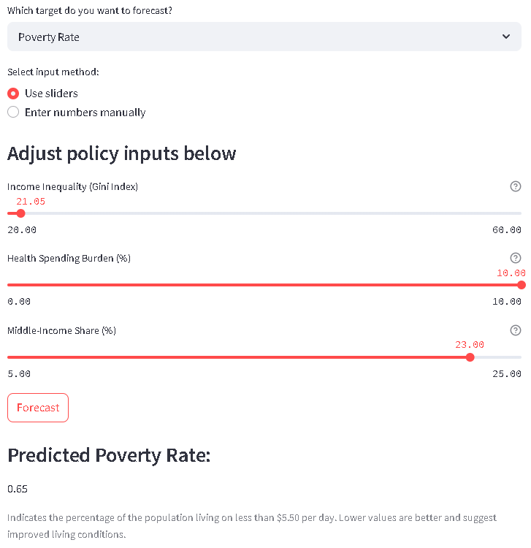
Drastically lowering income inequality and shifting resources to the middle class significantly reduces projected poverty. However, a spike in health cost burden slightly offsets gains, showing how multiple factors can work against each other. Scenario B represents a high-equity but high-risk health environment.

Slide 15
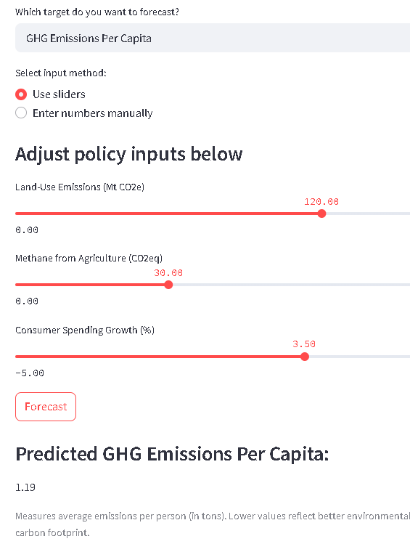
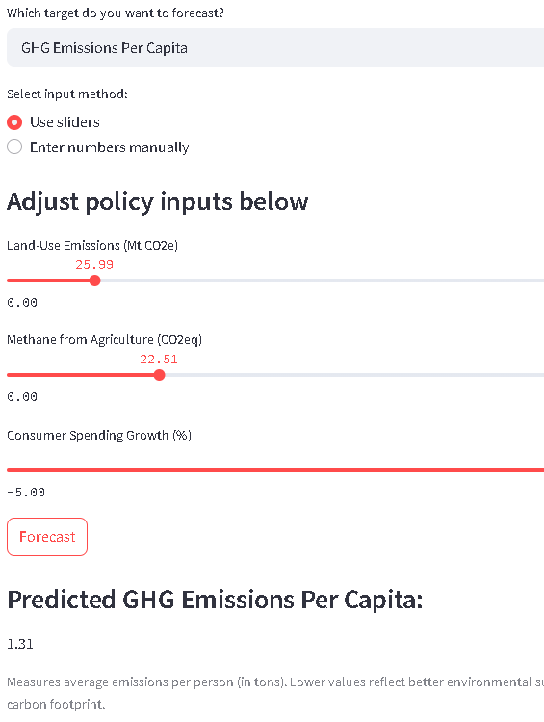
Cutting land-use and agricultural emissions significantly reduces per-person carbon output. However, strong consumer growth can partially offset environmental gains. Scenario B reflects a high-growth, high-consumption path that raises emissions despite lower methane and land use activity.

Slide 16
Impact and Applications
Forecasts are fast, transparent, and scenario based
Helps policymakers assess tradeoffs (growth vs. sustainability)
Can be expanded to other countries or indicators

Slide 17
Thank You
Reach out for collaborations, feedback, or ideas

